Slide 1
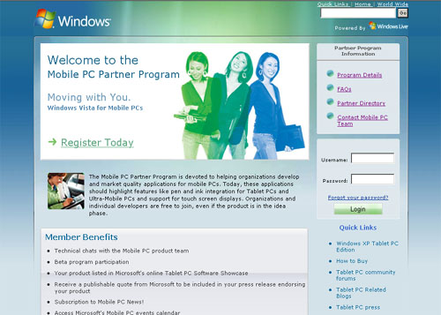
Microsoft Tablet Partner Program BI
The Challenge
Before there was a market for Tablet PC’s, Microsoft needed a way to encourage vendors to build applications for tablets while at the same time convincing consumers to purchase these new devices.
What We Did
We created a market place for Microsoft to sell more Tablets by encouraging Independent Software Vendors (ISVs) to build applications. We tracked thousands of ISVs and their product offerings and built an Interactive Software Showcase for users to find the applications they need for their Tablets. The program was so successful, we localized it for the MS Japan Tablet Group.
Results
Microsoft has sold millions of tablets since the creation of the Tablet PC Partner Program and our custom marketplace has generated thousands of leads for ISVs. The Tablet PC Partner Program was so successful, that it has since been integrated into the Microsoft Umbrella Partner Program.

